Slide 1


ARTIFICIAL INTELLIGENCE
Third Edition
Transparencies/Handouts
Chapter 3
Heuristic Search Techniques
PROPRIETARY MATERIAL. © 2009 The McGraw-Hill Companies, Inc. All rights reserved. No part of this PowerPoint slide may be displayed, reproduced or distributed in any form or by any means, without the prior written permission of the publisher, or used beyond the limited distribution to teachers and educators permitted by McGraw-Hill for their individual course preparation. If you are a student using this PowerPoint slide, you are using it without permission.
43

Slide 2
Some Cryptarithmetic Problems
→ Depth-first search
→ Breadth-first search
→ Generate-and-test
→ Hill climbing
→ Best-first search
→ Problem reduction
→ Constraint satisfaction
→ Means-ends analysis
44

Slide 3
Algorithm : Generate-and-Test
Generate a possible solution.
Test to see if this is actually a solution by comparing the chose point or the endpoint of the chosen path to the set of acceptable goal states.
If a solution has been found, quit. Otherwise, return to step 1.
45

Slide 4
Algorithm : Simple Hill-Climbing
1. Evaluate the initial state. If it is also a goal state, then return it and quit. Otherwise, continue with the initial state as the current state.
2. Loop until a solution is found or until there are no new operators left to be applied in the current state:
Select an operator that has not yet been applied to the current state and apply it to produce a new state.
(b) Evaluate the new state.
If it is a goal state, then return it and quit.
(ii) If it is not a goal state but it is better than the current state, then make it the current state.
(iii) If it is not better than the current state, then continue in the loop.
46

Slide 5
Algorithm : Steepest-Ascent Hill Climbing
1. Evaluate the initial state. If it is also a goal state, then return it and quit. Otherwise, continue with the initial state as the current state.
2. Loop until a solution is found or until a complete iteration produces no change to current state:
Let SUCC be a state such that any possible successor of the current state will be better than SUCC.
(b) For each operator that applies to the current state do:
  Apply the operator and generate a new state.
  (ii) Evaluate the new state. If it is a goal state, then return it and quit. If not, compare it to SUCC. If it is better, then set SUCC to this state. If it is not better, leave SUCC alone.
(c) If the SUCC is better than current state, then set current state to SUCC.
47

Slide 6


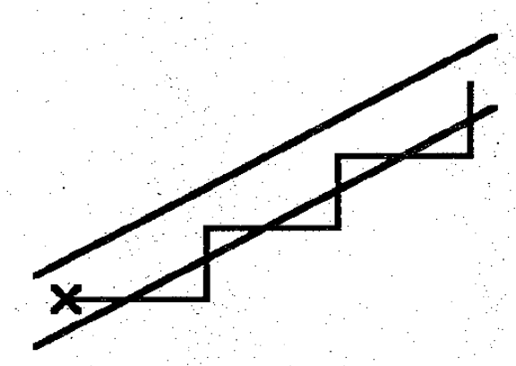
Hill-Climbing Dangers
· Local maximum
· Plateau
· Ridge
48

Slide 7
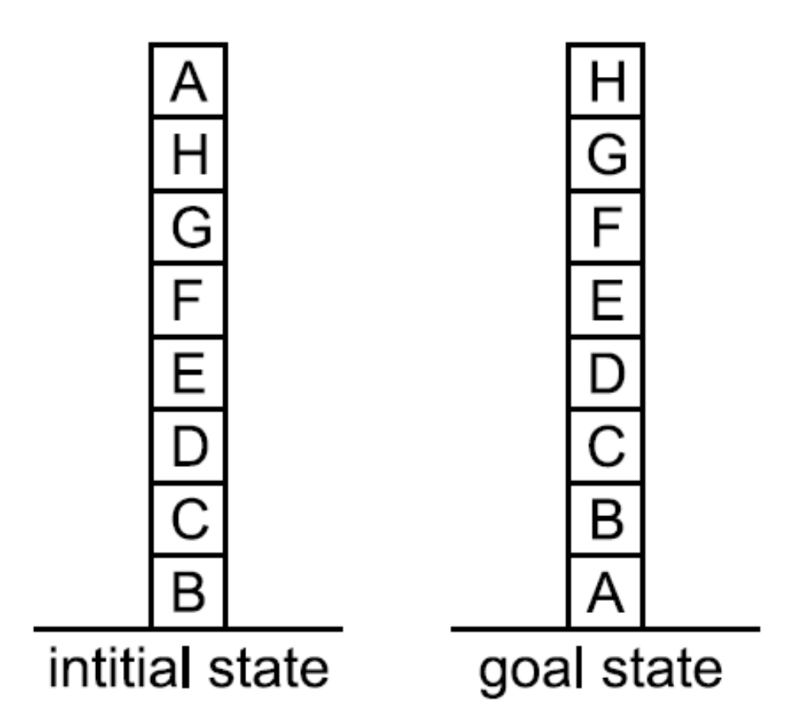
A Hill-Climbing Problem
49

Slide 8
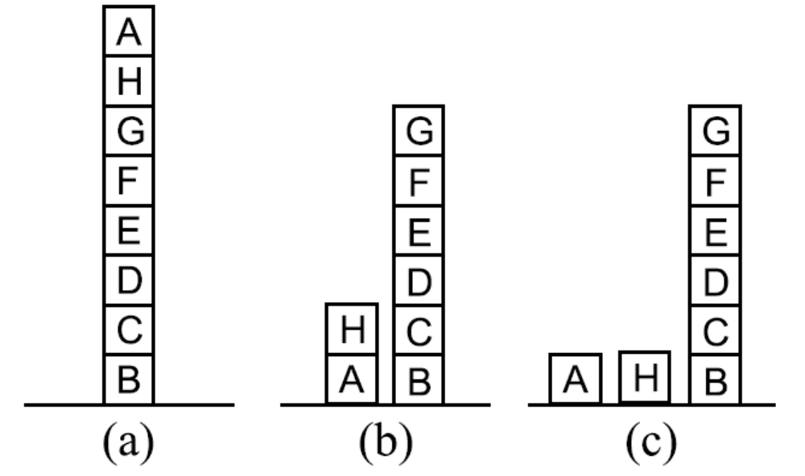
Three Possible Moves
50

Slide 9

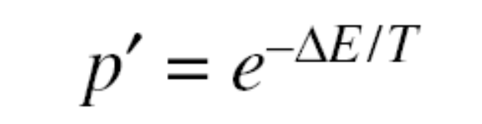
Simulated Annealing
Original Probability Definition :
Original Probability Definition :
51

Slide 10
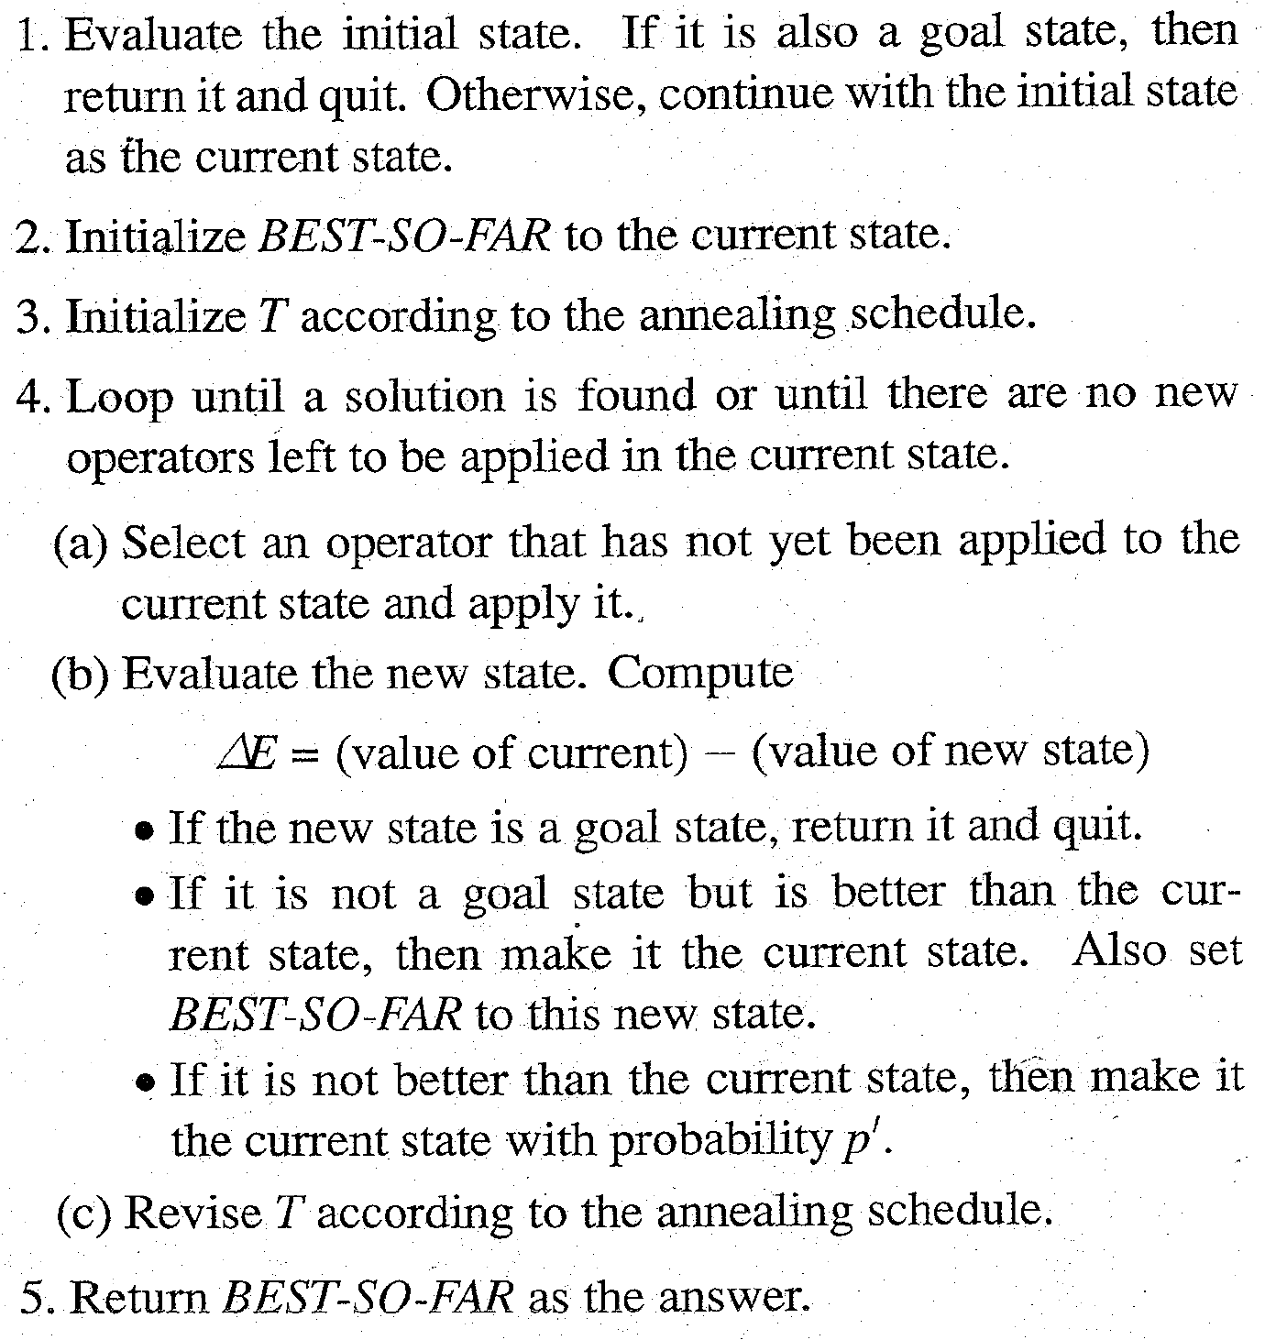
Algorithm : Simulated Annealing
52

Slide 11
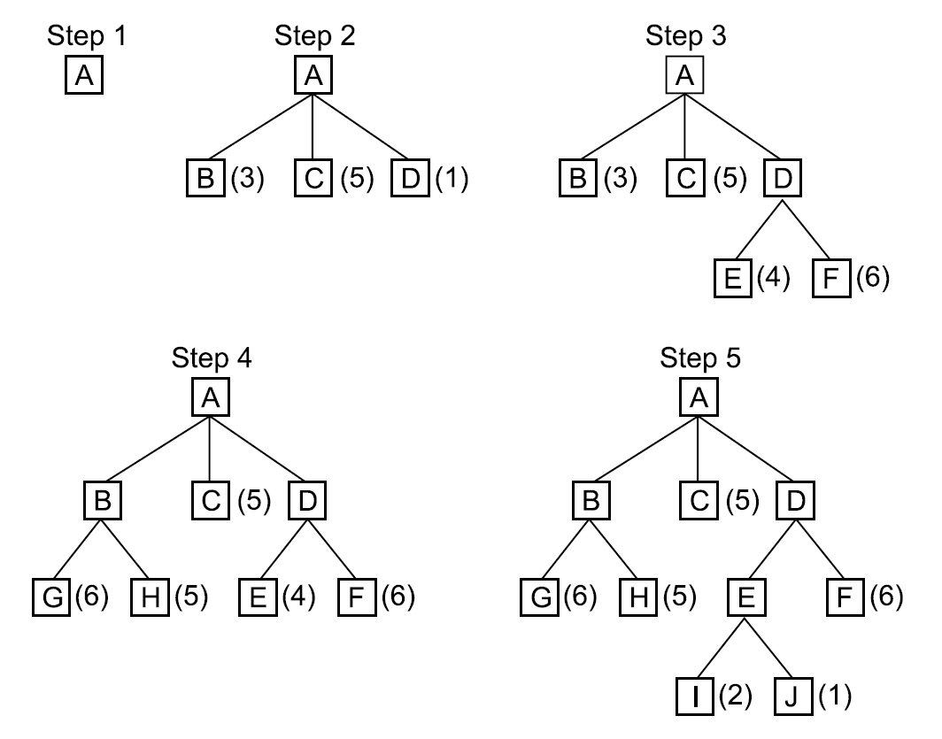
A Best-First Search
53

Slide 12
Algorithm : Best-First Search
Start with OPEN containing just the initial state.
2. Until a goal is found or there are no nodes left on OPEN do:
(a) Pick them best node on OPEN.
(b) Generate its successors.
(c) For each successor do:
(i) If it has not been generated before, evaluate it, add it to OPEN, and record its parent.
(ii) If it has been generated before, change the parent if this new path is better than the previous one. In that case, update the cost of getting to this node and to any successors that this node may already, have.
54

Slide 13
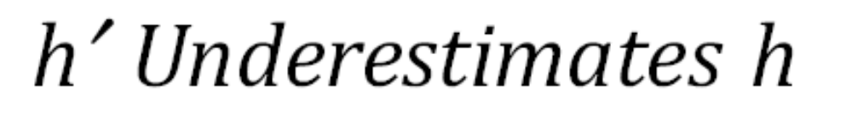
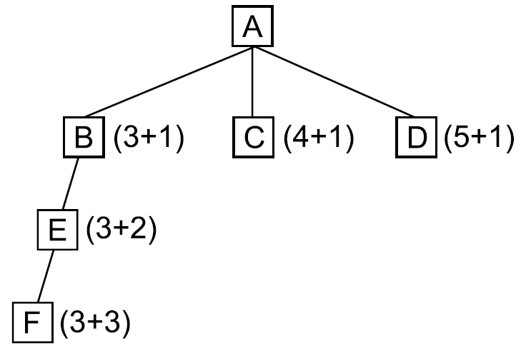
55

Slide 14

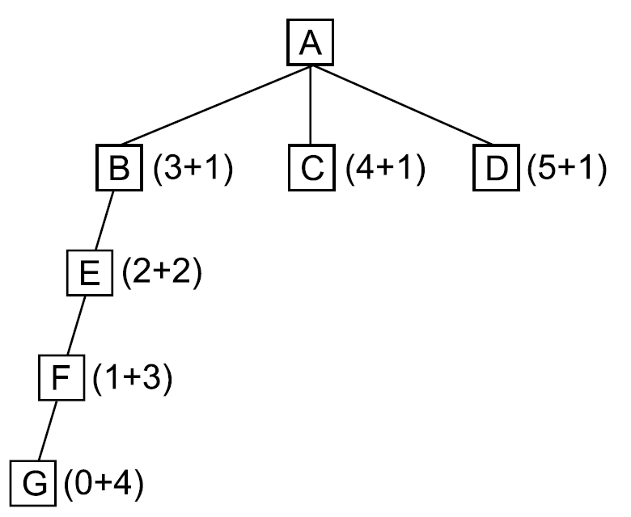
56

Slide 15
Algorithm : Agenda-Driven Search
Do until a goal state is reached or the agenda is empty:
Choose the most promising task from the agenda. Notice that this task can be represented in any desired form. It can be thought of as an explicit statement of what to do next or simply as an indication of the next node to be expanded.
(b) Execute the task by devoting to it the number of resources determined by its importance. The important resources to consider are time and space. Executing the task will probably generate additional tasks (successor nodes). For each of them, do the following:
See if it is already on the agenda. If so, then see if this same reason for doing it is already on its list of justifications. If so, ignore this current evidence. If this justification was not already present, add it to the list. If the task was not on the agenda, insert it.
(ii) Compute the new task’s rating, combining the evidence from all its justifications.
57

Slide 16
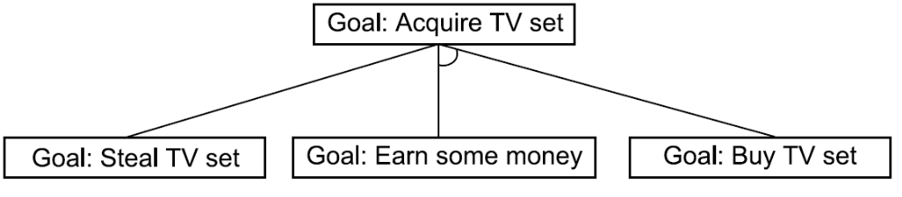
A Simple AND-OR Graph
58

Slide 17
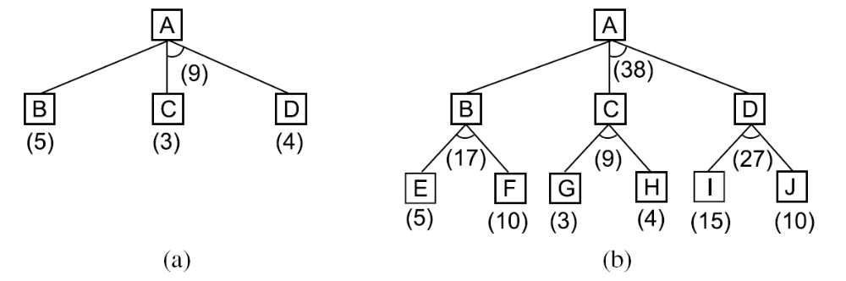
AND-OR Graphs
59

Slide 18
Algorithm : Problem Reduction
Initialize the graph to the starting node.
2. Loop until the starting node is labeled SOLVED or until its cost goes above FUTILITY:
(a) Traverse the graph, starting at the initial node and following the current best path, and accumulate the set of nodes that are on that path and have not yet been expanded or labeled as solved.
(b) Pick one of these unexpanded nodes and expand it. If there are no successors, assign FUTILITY as the value of this node. Otherwise, add its successors to the graph and for each of them compute f ′ (use only h′ and ignore g, for reasons we discuss below). If of any node is 0, mark that node as SOLVED.
(c) Change the f ′ estimate of the newly expanded node to reflect the new information provided by its successors. Propagate this change backward through the graph. If any node contains a successor arc whose descendants are all solved, label the node itself as SOLVED. At each node that is visited while going up the graph, decide which of its successor arcs is the most promising and mark it as part of the current best path.
60

Slide 19
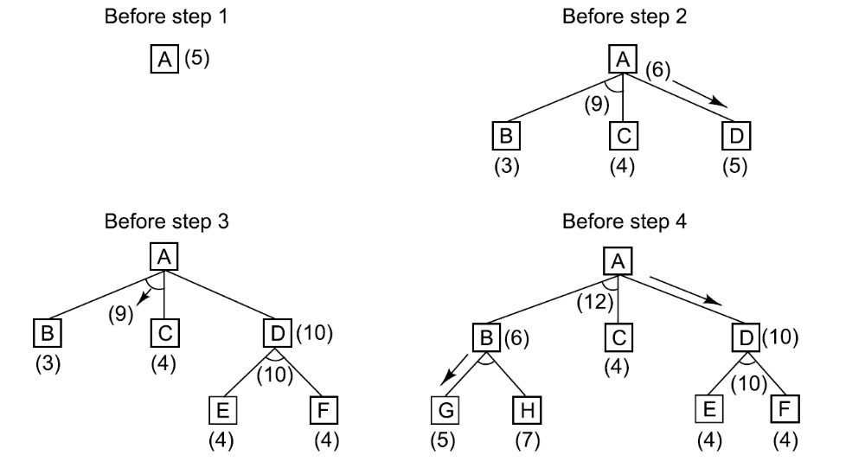
The Operation of Problem Reduction
61

Slide 20
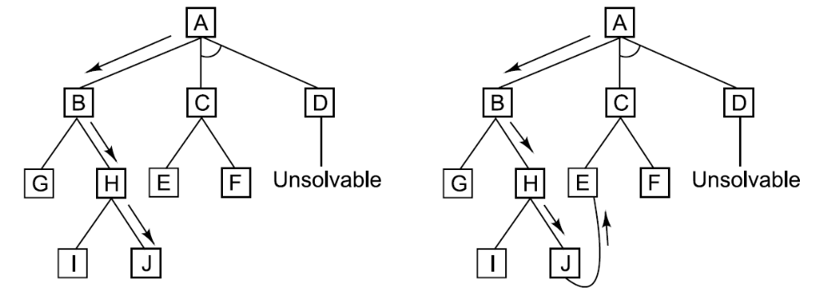
A Longer Path May Be Better
62

Slide 21
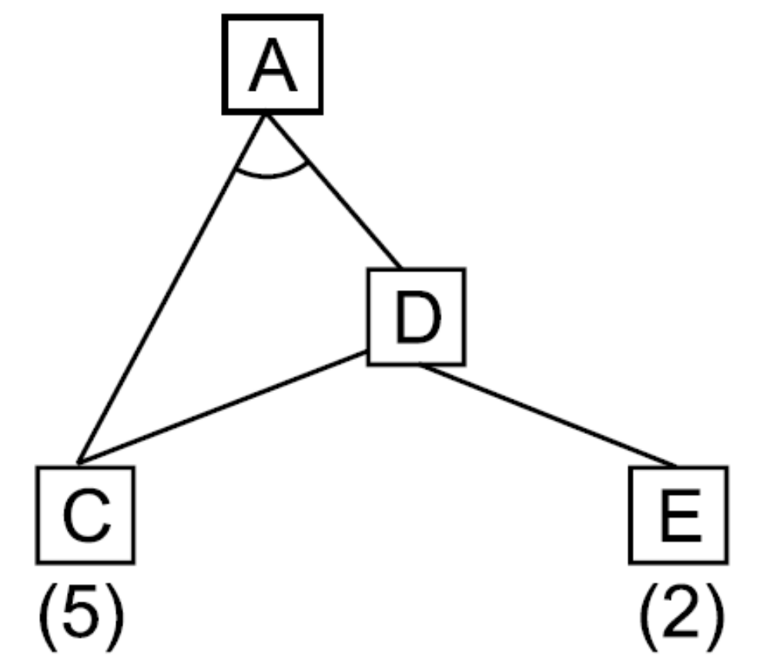
Interacting Subgoals
63

Slide 22
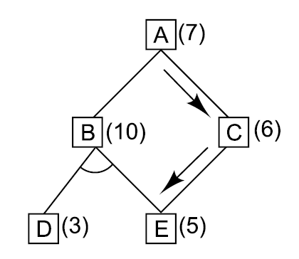
An Unnecessary Backward Propagation
64

Slide 23
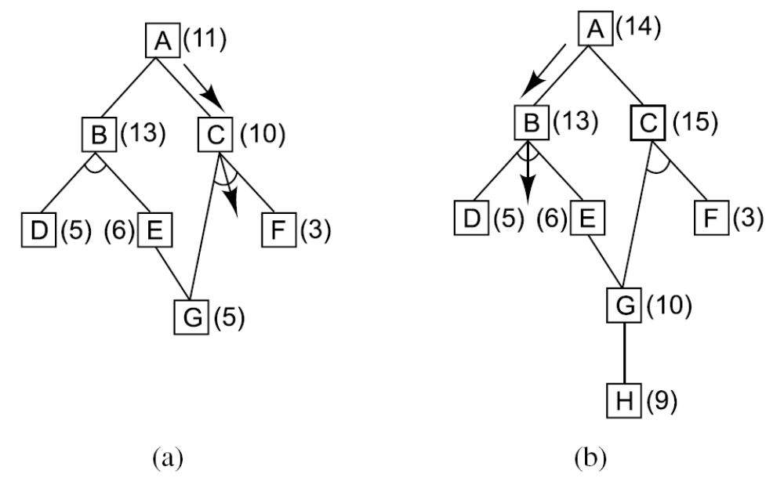
A Necessary Backward Propagation
65

Slide 24
Algorithm : Constraint Satisfaction
1. Propagate available constraints. To do this, first set OPEN to the set of all objects that must have values assigned to them in a complete solution. Then do until an inconsistency is detected or until OPEN is empty:
(a) Select an object OB from OPEN. Strengthen as much as possible the set of constraints that apply to OB.
(b) If this set is different from the set that was assigned the last time OB was examined or if this is the first time OB has been examined, then add to OPEN all objects that share any constraints with OB.
(c) Remove OB from OPEN.
2. If the union of the constraints discovered above defines a solution, then quit and report the solution.
3. If the union of the constraints discovered above defines a contradiction, then return failure.
4. If neither of the above occurs, then it is necessary to make a guess at something in order to proceed. To do this, loop until a solution is found or all possible solutions have been eliminated:
(a) Select an object whose value is not yet determined and select a way of strengthening the constraints on that object.
(b) Recursively invoke constraint satisfaction with the current set of constraints augmented by the strengthening constraint just selected.
66

Slide 25
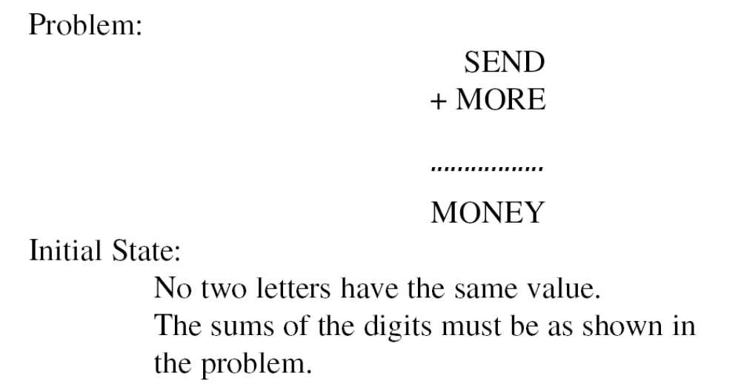
A Cryptarithmetic Problem
67

Slide 26
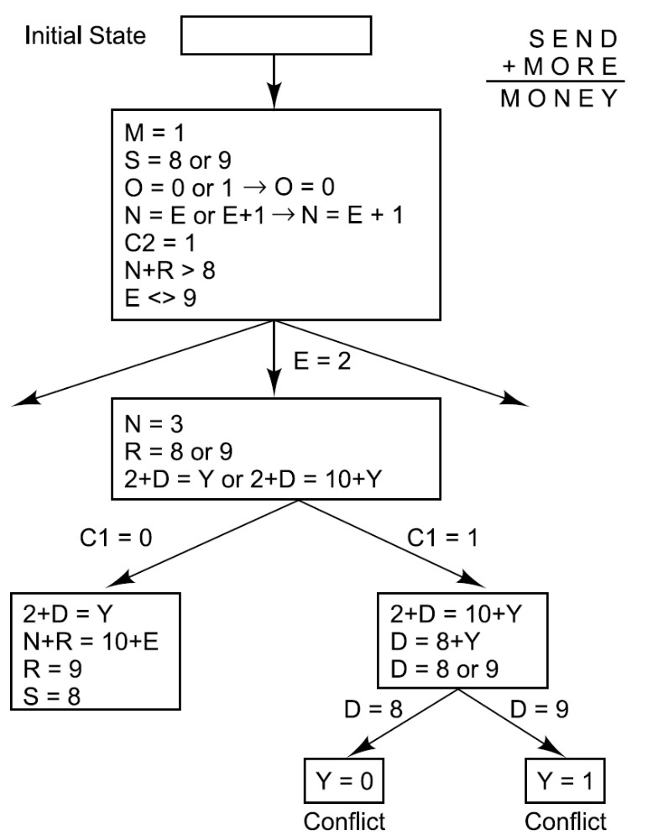
Solving a Cryptarithmetic Problem
68

Slide 27
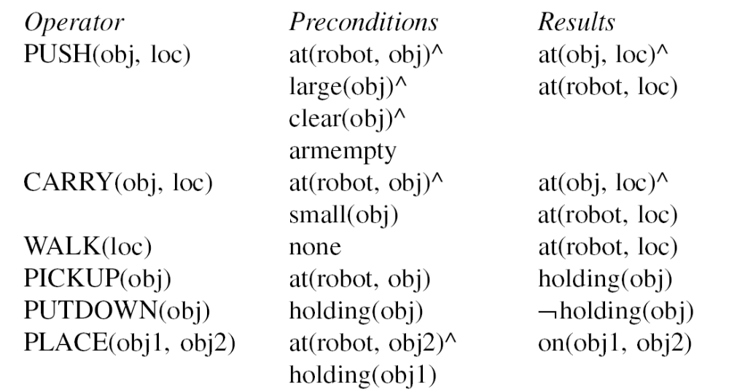
A Robot’s Operators
69

Slide 28
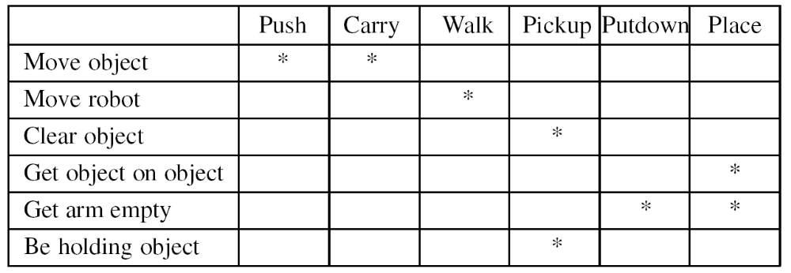
A Difference Table
70

Slide 29
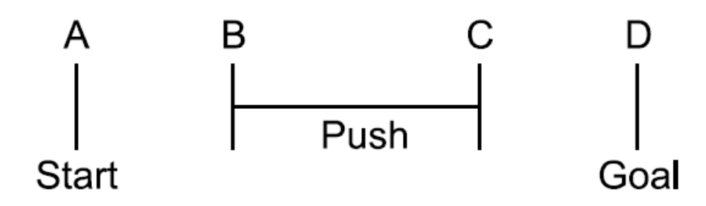
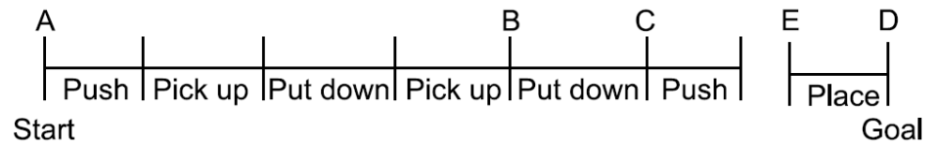
The Progress of the Means-Ends Analysis Methods
71

Slide 30
Algorithm : Means-Ends Analysis
Compare CURRENT to GOAL. If there are no differences between them then return.
2. Otherwise, select the most important difference and reduce it by doing the following until success or failure is signaled:
Select an as yet untried operator O that is applicable to the current difference. If there are no such operators, then signal failure.
(b) Attempt to apply O to CURRENT. Generate descriptions of two states: O-START, a state in which O’s preconditions are satisfied and O-RESULT, the state that would result if O were applied in OSTART.
(c) If
(FIRST-PART ← MEA(CURRENT, O-START))
and
(LAST-PART ← MEMO-RESULT, GOAL))
are successful, then signal success and return the result of concatenating
FIRST-PART, O, and LAST-PART.
72

Slide 31
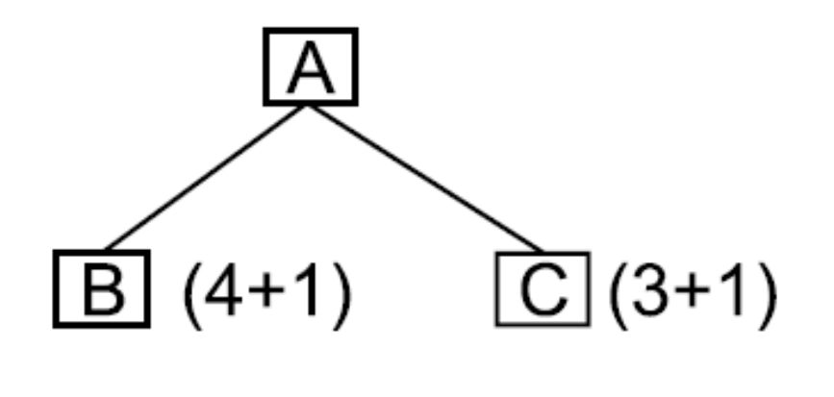
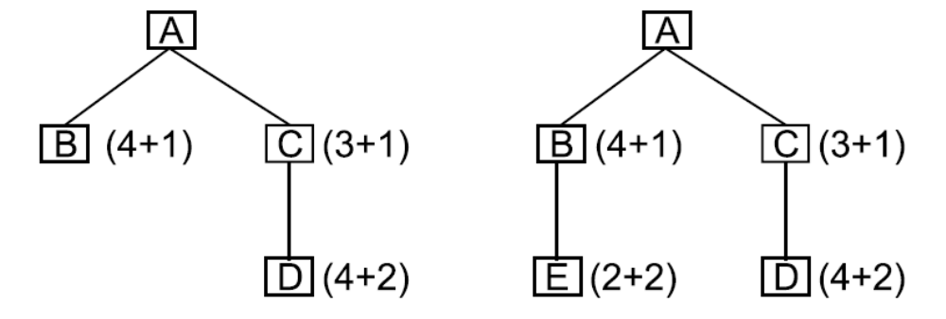
Exercise 5
73

Slide 32
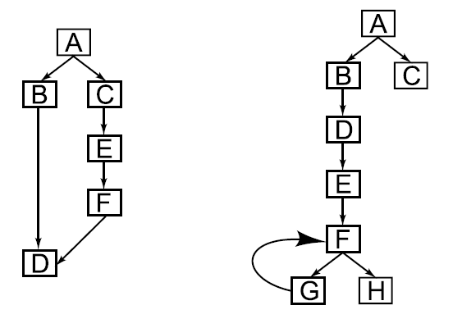
Exercise 6
74

Slide 33
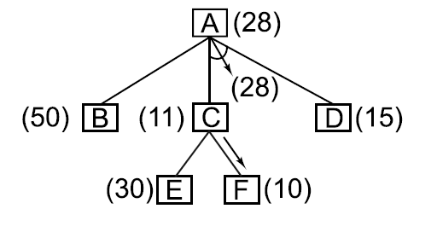
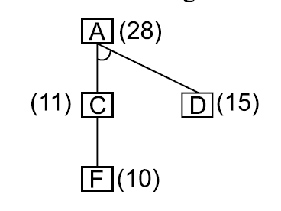
Exercise 9
75

Slide 34
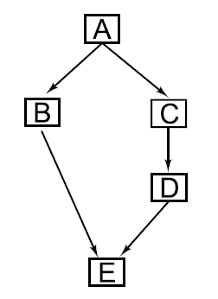
Exercise 10
76

Slide 35
Summary
In Chapter 2, we listed four steps that must be taken to design a program to solve an AI problem. The first two steps were:
1. Define the problem precisely. Specify the problem space, the operators for moving within the space, and the starting and goal state(s).
2. Analyze the problem to determine where it falls with respect to seven important issues.
The other two steps were to isolate and represent the task knowledge required, and to choose problem solving techniques and apply them to the problem. In this chapter, we began our discussion of the last step of this process by presenting some general-purpose, problem-solving methods. There are several important ways in which these algorithms differ, including:
• What the states in the search space(s) represent. Sometimes the states represent complete potential solutions (as in hill climbing). Sometimes they represent solutions that are partially specified (as in constraint satisfaction).
• How, at each stage of the search process, a state is selected for expansion.
• How operators to be applied to that node are selected.
• Whether an optimal solution can be guaranteed.
• Whether a given state may end up being considered more than once.
• How many state descriptions must be maintained throughout the Search process.
• Under what circumstances should a particular search path be abandoned.
In the chapters that follow, we talk about ways that knowledge about task domains can be encoded inproblem-solving programs and we discuss techniques for combining problem-solving techniques with knowledge to solve several important classes of problems.

